Slide 1
Grade 1 • Module 1 • Lesson 6
In this lesson:
Warm-Up Routines: Isolating Phonemes; Adding Final Phonemes, Syllables
High-Frequency Words: a, first, good, had, he, I, my, was
Phonological Awareness: Blend Onset and Rime; Blend Phonemes
Phonics: Consonants n, d, p, c /k/; Short a
Spelling: Short a
Handwriting: Lowercase a, d
Notes:
This PowerPoint file contains an instructional delivery tool for teachers who have purchased the HMH Into Reading program. These daily foundational skills lessons facilitate both in-class and remote delivery of the research-based approach in your Teacher’s Guide, following the program’s foundational skills scope and sequence.
First, view the slides when planning your lesson and use them to help anticipate children’s responses or prepare any additional materials you may want to have on hand. Decide which slides you will use with the class. The content on the slides is editable. During instruction, project the slides to children and use the suggested model language in the Notes to guide them through the lesson.
Because some of the slides may involve manipulating letter and word “tiles” as part of the instructional delivery, we recommend presenting the file in edit mode vs slide show mode.

Slide 2
Warm-Up Routines
Notes:
(Note: The activity on this slide is isolating phonemes. If children are not ready, or you prefer to have them try this activity after more formal instruction on phonemes, you can skip these slides.)
Say: Let’s warm up by listening for sounds in words! We’re going to move a finger up when we say a specific sound in a word. The hand on the screen shows us what to do.
I’ll do the first one. The word is pan. I will listen for the sound at the beginning of pan. Do the movement as you isolate the first sound. Pan. The sound at the beginning is /p/.
Now let’s all listen for specific sounds in words together! Remember to do the movement. Ready?
Sad. What is the sound at the beginning of sad? Say the word and point out the sound at the beginning. (sad, /s/)
Cat. What is the sound at the beginning of cat? Say the word and point out the sound at the beginning. (cat, /k/)
Nap. What is the sound at the beginning of nap? Say the word and point out the sound in the middle. (nap, /n/)
(Accessibility Note: As needed, work with children before the lesson to determine an appropriate modification or replacement motion, keeping in mind the need to use one movement consistently for each skill. Give each child enough time to explore and practice the movement.)

Slide 3
Warm-Up Routines
Notes:
(Note: The activity on this slide is adding phonemes. If children are not ready, or you prefer to have them try this activity after more formal instruction on phonemes, you can skip these slides.)
Say: Let’s try adding final sounds to words! We’re going to slide an index finger toward our fist each time we add a sound to make a new word. The fist stands for the word we start with, and the finger stands for the sound we are adding. The hands on the screen show us what to do.
(Note: Since a phoneme is added to the end of a word, children should hold out their left fist. As the teacher, reverse your hands so that children see the motions in the correct, mirrored order.)
Say: I’ll do the first one. The word is car. Hold out your right fist. I’m going to add the /t/ sound to the end of car. Move the finger of your other hand toward your fist as you add the phoneme and say the new word. Car, add /t/. Cart.
Now let’s all add ending sounds together! Remember to do the movement. Ready?
Part. Add the /ē/ sound to the end. What’s the new word? (party)
How. Add the /s/ sound to the end. What’s the new word? (house)
Lie. Add the /t/ sound to the end. What’s the new word? (light)

Slide 4
Warm-Up Routines
Notes:
(Note: The activity on this slide is adding syllables. If children are not ready, or you prefer to have them try this activity after more formal instruction on syllables, you can skip these slides.)
Say: Now let’s add final syllables to words! We’re going to slide a hand toward our fist each time we add a syllable to make a new word. The fist stands for the word we start with, and the hand stands for the syllable we add. The hands on the screen show us what to do.
(Note: Since a syllable is added to the end of a word, children should hold out their left fist. As the teacher, reverse your hands so that children see the motions in the correct, mirrored order.)
Say: I’ll do the first one. The word is dig. Hold out your right fist. I’m going to add ing to the end of dig. Move your other hand toward your fist as you add the syllable and say the new word. Dig, add ing. Digging.
Now let’s all add final syllables together! Remember to do the movement. Ready?
Miss. Add the syllable take to the end. What’s the new word? (mistake)
Pack. Add the syllable er to the end. What’s the new word? (packer)
Red. Add the syllable y to the end. What’s the new word? (ready)
Nice work!

Slide 5
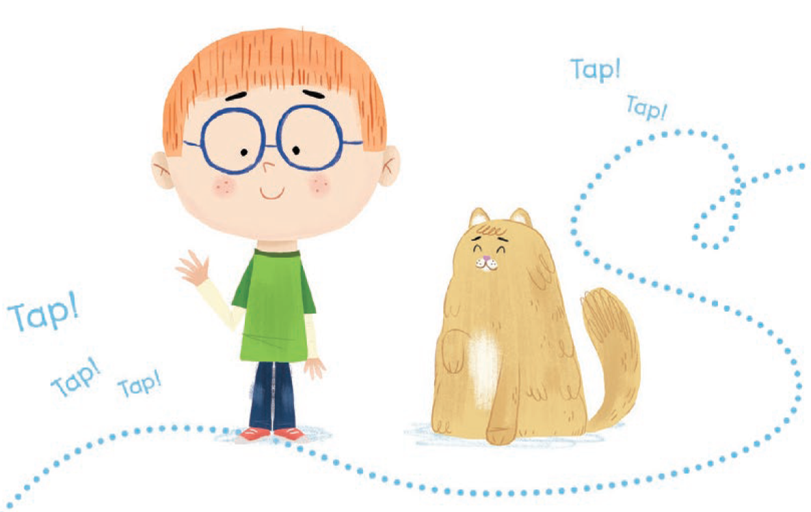
Meet Dan and Tab! Dan and Tab like to tap. How do you think Dan will tap?
©Houghton Mifflin Harcourt Publishing Company
Notes:
Say: This week we will meet the characters Dan and Tab. Dan and Tab like to tap. How do you think Dan will tap?
We will have to learn some words and skills before we read so we can find out what these characters do.
Have children discuss different ways to tap.
(Note: These characters are from the Start Right Reader decodable text “Dan Can Tap, Tap, Tap,” which is recommended for reading at the end of this lesson to apply understanding of new foundational skills, either in small groups or as independent reading for more skilled readers. The Start Right Reader decodable texts contain only previously taught phonic elements and high-frequency words.)

Slide 6
a
Follow the steps!
See the word.
Say the word.
Spell the word.
Write and check the word.
©Houghton Mifflin Harcourt Publishing Company
Notes:
(Note: Children will need something to write on for the High-Frequency Words slides in this lesson. Either a dry erase board or paper and pencil could be used.)
Say: The word is a /ə/. Let’s follow the steps we use to learn new words.
Look at the word. Repeat the word after me, a.
A. I planted a tree. Say the word again after me, a.
Look at the letter in the word. Let’s spell it aloud: a. The letter a can stand for long, short, or other sounds. When the letter a is used as a word, it usually stands for the sound /ə/. Repeat after me: /ə/, a.
Now write the word a. Try to write it without looking. Then check it.
Are you ready for the next word?

Slide 7
first
Follow the steps!
See the word.
Say the word.
Spell the word.
Write and check the word.
©Houghton Mifflin Harcourt Publishing Company
Notes:
Say: The word is first. Let’s follow the steps.
Look at the word. Repeat the word after me, first.
First. The line leader is the first in line. Say the word again after me, first.
Look at the letters in the word. Let’s spell it aloud: f-i-r-s-t. The letters i-r stand for the sound /ûr/. Blend with me: /f/ /ûr/ /s/ /t/, first.
Now write the word first. Try to write it without looking. Then check it.
Are you ready for the next word?

Slide 8
good
Follow the steps!
See the word.
Say the word.
Spell the word.
Write and check the word.
©Houghton Mifflin Harcourt Publishing Company
Notes:
Say: The word is good. Let’s follow the steps.
Look at the word. Repeat the word after me, good.
Good. Have you read any good books lately? Say the word again after me, good.
Look at the letters in the word. Let’s spell it aloud: g-o-o-d. The letters o-o stand for the sound /o͝o/. Blend with me: /g/ /o͝o/ /d/, good.
Now write the word good. Try to write it without looking. Then check it.
Are you ready for the next word?

Slide 9
had
Follow the steps!
See the word.
Say the word.
Spell the word.
Write and check the word.
©Houghton Mifflin Harcourt Publishing Company
Notes:
Say: The word is had. Let’s follow the steps.
Look at the word. Repeat the word after me, had.
Had. He had treats to share with everyone. Say the word again after me, had.
Look at the letters in the word. Let’s spell it aloud: h-a-d. The letter a stands for the short a sound, /ă/. Blend with me: /h/ /ă/ /d/, had.
Now write the word had. Try to write it without looking. Then check it.
Are you ready for the next word?

Slide 10
he
Follow the steps!
See the word.
Say the word.
Spell the word.
Write and check the word.
©Houghton Mifflin Harcourt Publishing Company
Notes:
Say: The word is he. Let’s follow the steps.
Look at the word. Repeat the word after me, he.
He. He is the boy who found the lost kitten. Say the word again after me, he.
Look at the letters in the word. Let’s spell it aloud: h-e. The letter e stands for the long e sound, /ē/. Blend with me: /h/ /ē/, he.
Now write the word he. Try to write it without looking. Then check it.
Are you ready for the next word?

Slide 11
I
Follow the steps!
See the word.
Say the word.
Spell the word.
Write and check the word.
©Houghton Mifflin Harcourt Publishing Company
Notes:
Say: The word is I. Let’s follow the steps.
Look at the word. Repeat the word after me, I.
I. I like to visit my grandpa. Say the word again after me, I.
Look at the letter in the word. Let’s spell it aloud: I. The letter I stands for the long i sound, /ī/. Repeat after me: /ī/, I.
Now write the word I. Try to write it without looking. Then check it.
Are you ready for the next word?

Slide 12
my
Follow the steps!
See the word.
Say the word.
Spell the word.
Write and check the word.
©Houghton Mifflin Harcourt Publishing Company
Notes:
Say: The word is my. Let’s follow the steps.
Look at the word. Repeat the word after me, my.
My. I am proud of my brother. Say the word again after me, my.
Look at the letters in the word. Let’s spell it aloud: m-y. The letter y stands for the long i sound, /ī/. Blend with me: /m/ /ī/, my.
Now write the word my. Try to write it without looking. Then check it.
Are you ready for the next word?

Slide 13
was
Follow the steps!
See the word.
Say the word.
Spell the word.
Write and check the word.
©Houghton Mifflin Harcourt Publishing Company
Notes:
Say: The word is was. Let’s follow the steps.
Look at the word. Repeat the word after me, was.
Was. Yesterday was his birthday. Say the word again after me, was.
Look at the letters in the word. Let’s spell it aloud: w-a-s. In this word, the letter a stands for the short u sound, /ŭ/. The letter s stands for the sound /z/. Blend with me: /w/ /ŭ/ /z/, was.
Now write the word was. Try to write it without looking. Then check it.

Slide 14
my
a
first
good
had
he
I
was
©Houghton Mifflin Harcourt Publishing Company
Notes:
Say: Let’s read all the new words we learned together, starting on the first line: a, first, good, had, he, I, my, was.
Optional: Ask one or two volunteers to pick a word and use it in an oral sentence.
You may want to assign children to complete Know It, Show It page 15 for independent work.

Slide 15
Let’s play with the sounds in words!
©Houghton Mifflin Harcourt Publishing Company
Notes:
Say: Now let’s play with the sounds in words!

Slide 16
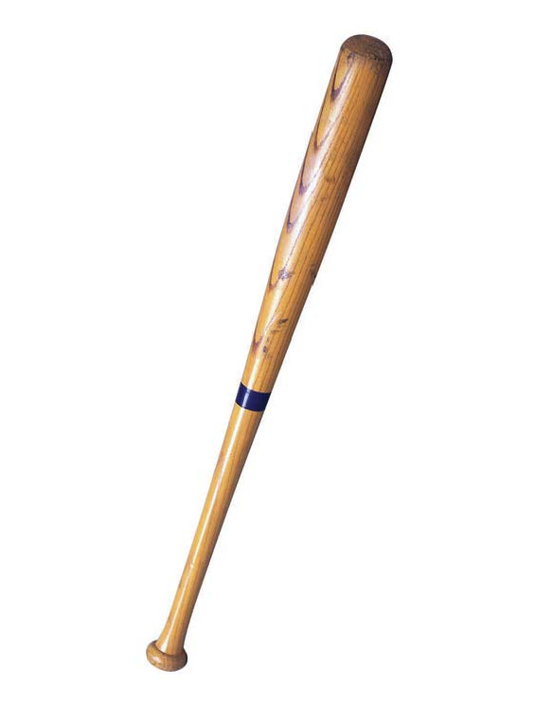
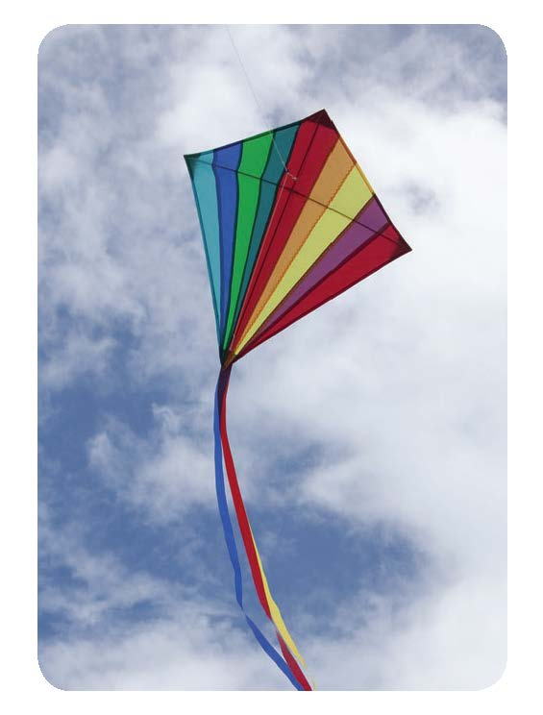
©Houghton Mifflin Harcourt Publishing Company • Image: ©Corbis, ©Edward Westmacott/Shutterstock, ©Houghton Mifflin Harcourt
Notes:
(Note: The activity on this slide is blending onset and rime.)
Say: Remember that words can be broken into chunks, and you know how to blend chunks to say words. I will say a word in two chunks: the beginning and the rest of the word. I want you to help me say the word. Listen while I do the first one: /k/ /ärd/. I can blend the two chunks together to say the word. /k/ /ärd/, card. The word is card.
Now you try it: /m/ /ān/. What is the word? (main)
Nice work! Let’s keep going. As you blend word chunks to say words, pat your head if the word you say matches one of the pictures. Not all the words you say will have a picture match. Blend these word chunks to say the word:
/p/ /ĕn/ (pen)
/m/ /ŏp/ (mop)
/t/ /āp/ (tape)
/k/ /īt/ (kite)
/s/ /ăd/ (sad)
/n/ /ōz/ (nose)
/b/ /ăt/ (bat)

Slide 17
Phonological Awareness
Notes:
(Note: You may want to incorporate the movement for blending phonemes from the bank of movements used in the Warm-Up Routines into the following slide(s). If you choose not to use the movement, skip or delete this slide.)

Slide 18
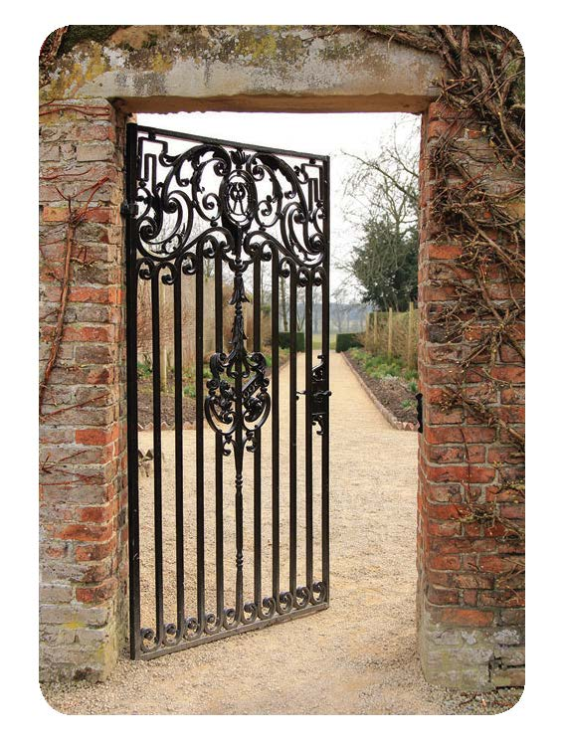
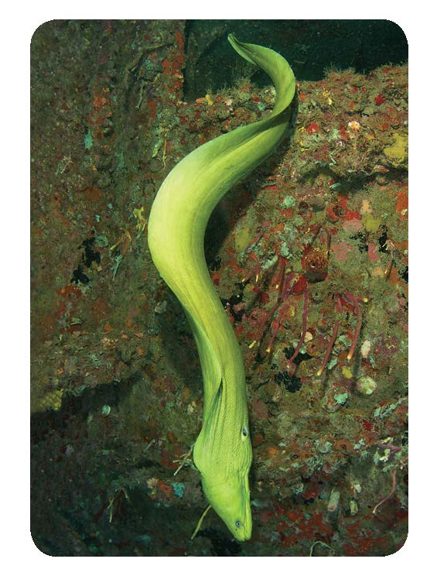
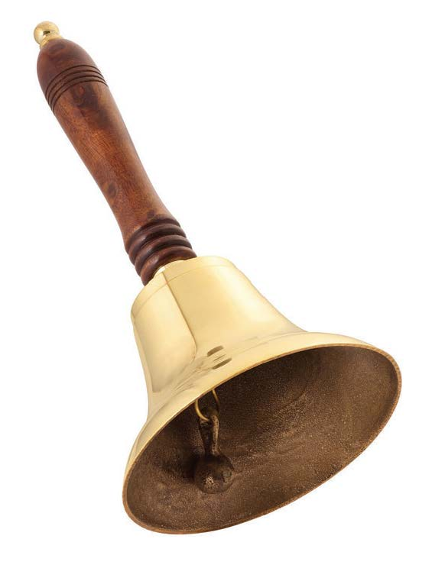
©Houghton Mifflin Harcourt Publishing Company • Image: ©Danny Smythe/Shutterstock, ©AC Rider/Shutterstock, ©Peter Leahy/Shutterstock
Notes:
(Note: The activity on this slide is blending phonemes.)
Say: Remember you also know how to blend all the sounds in a word to say the word. I will say all the sounds in a word, and you will blend the sounds to say the word. I will do the first one. Listen, the sounds are: /ĭ/ /n/. When I blend /ĭ/ and /n/, I say the word in. /ĭ/ /n/, in.
Are you ready to try? Listen: /ă/ /t/. What’s the word? (at) Very good!
Let’s see if you can blend the sounds to say these words. As you blend and say a word, see if the word you say matches a picture. Not every word you say has a picture match, so pay attention. Ready? Blend these sounds:
/ē/ /l/ (eel)
/ŏ/ /n/ (on)
/b/ /ĕ/ /l/ (bell)
/f/ /ŭ/ /n/ (fun)
/ĕ/ /g/ (egg)
/f/ /ĭ/ /l/ (fill)
/g/ /ā/ /t/ (gate)
Very good blending sounds!

Slide 19
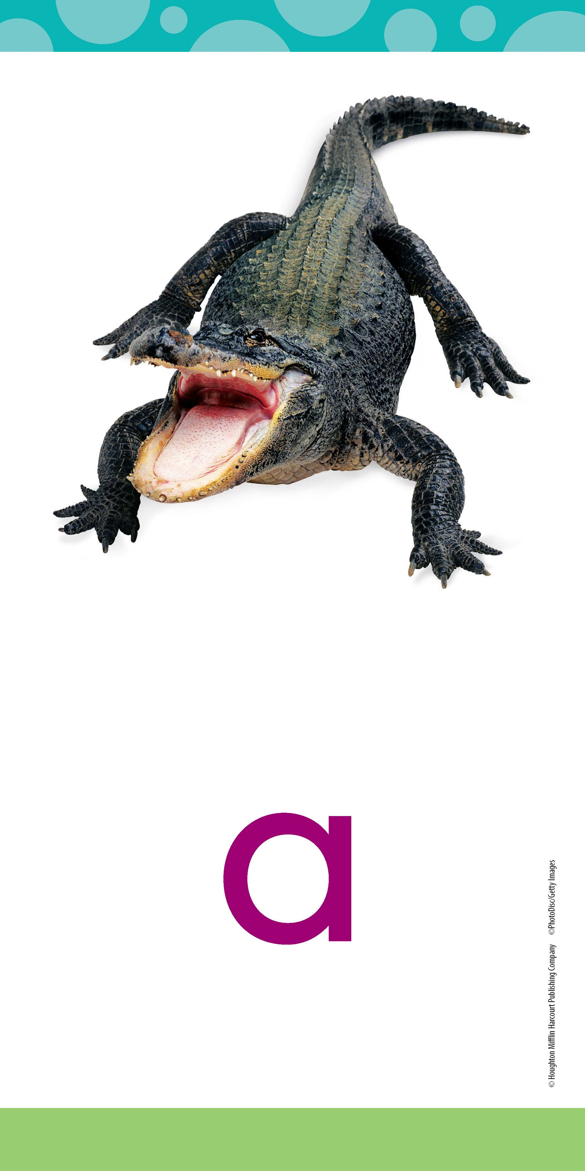
Short a sound as in ALLIGATOR
at
©Houghton Mifflin Harcourt Publishing Company
Notes:
Say: Alligator begins with the short a sound, /ă/. The letter a can stand for the sound /ă/ at the beginning or in the middle of a word.
Look at the word: /ă/ /t/, at. Remember, a is a vowel, so it can stand for many sounds, and t is a consonant. When there is only one vowel in a word, and it is followed by a consonant, the vowel usually stands for the short vowel sound.
Use an Articulation Video to show children how to articulate the /ă/ sound. If you are logged into Ed: Your Friend in Learning, you can copy and paste this link to access the video: https://www.hmhco.com/content/reading/common/reading_video_player/index.html?refid=kre_articulation_a_apple.

Slide 20
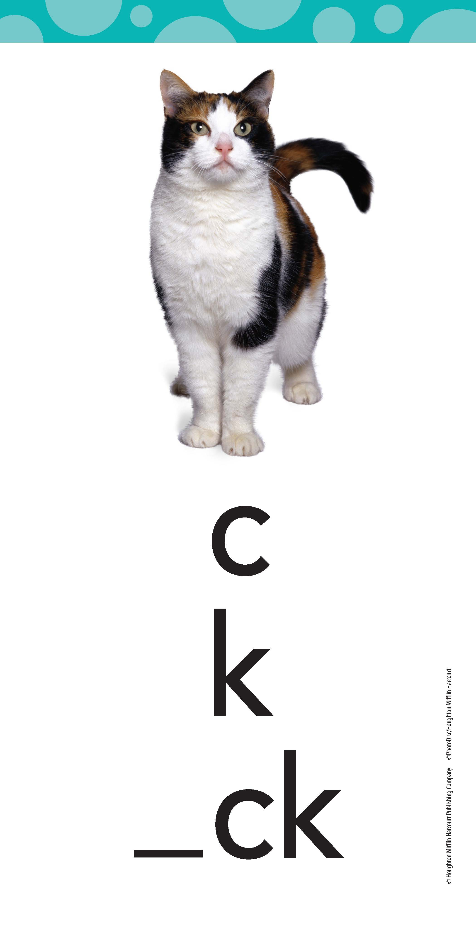
Sound for c as in CAT
cat
©Houghton Mifflin Harcourt Publishing Company
Notes:
Say: Cat begins with the hard c sound, /k/. The hard c sound can have different spellings. One spelling for the hard c sound is just the letter c. Look at the spelling that is circled under the picture of the cat, c.
Look at the word: /k/ /ă/ /t/, cat. Remember, c is a consonant; a is a vowel, so it can stand for many sounds; and t is a consonant. When there is only one vowel in a word, and it is followed by a consonant, the vowel usually stands for the short vowel sound.
Use an Articulation Video to show children how to articulate the /k/ sound. If you are logged into Ed: Your Friend in Learning, you can copy and paste this link to access the video: https://www.hmhco.com/content/reading/common/reading_video_player/index.html?refid=kre_articulation_k_kid.

Slide 21
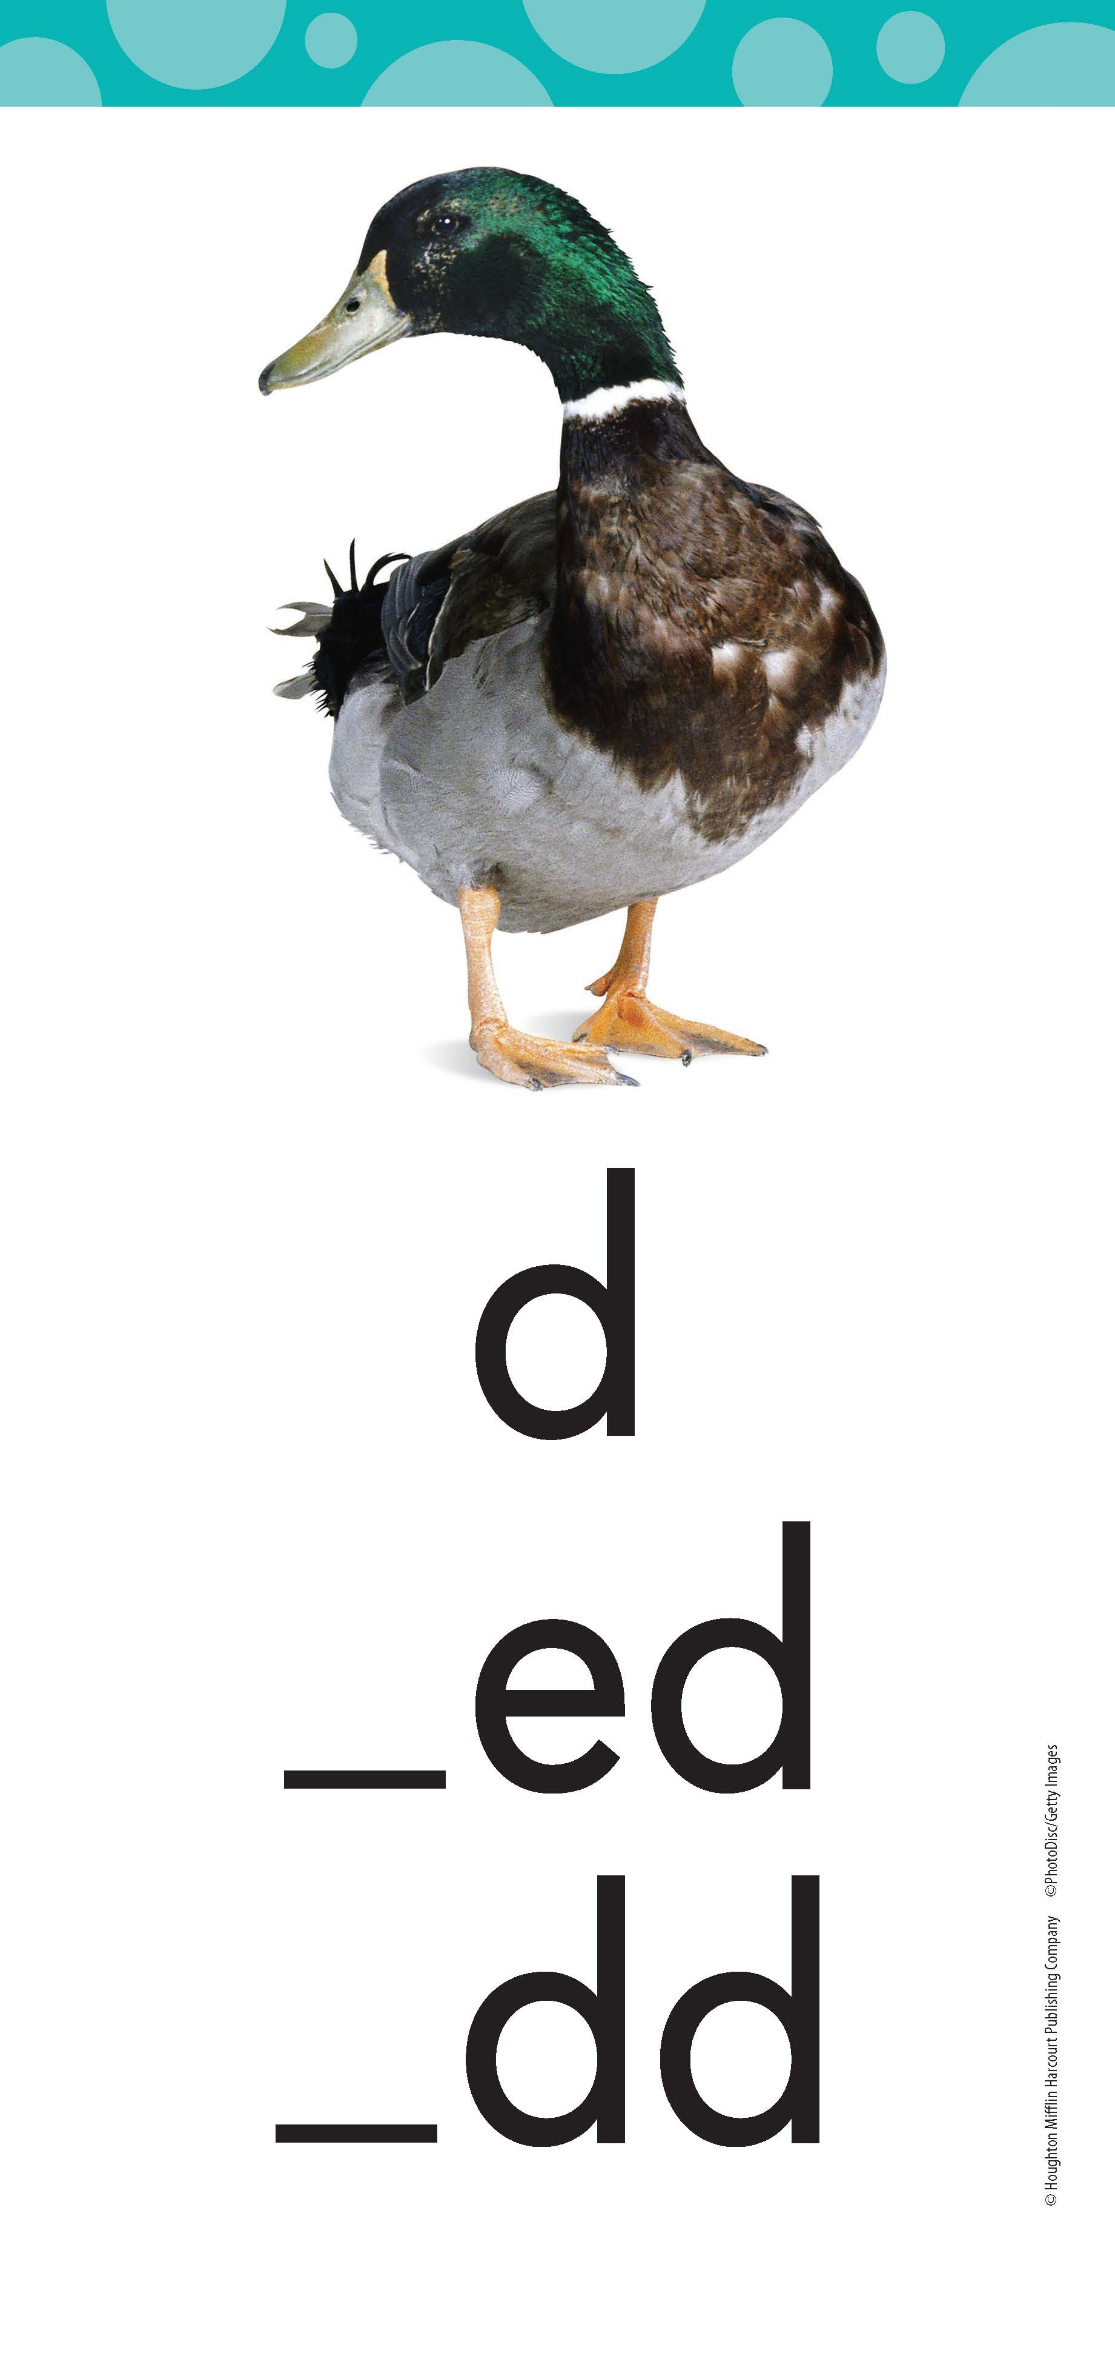
Sound for d as in DUCK
dad
©Houghton Mifflin Harcourt Publishing Company
Notes:
Say: Duck begins with the /d/ sound. The /d/ sound can have different spellings. One spelling for the /d/ sound is just the letter d. Look at the spelling that is circled under the picture of the duck, d.
Look at the word: /d/ /ă/ /d/, dad. Remember, d is a consonant and a is a vowel, so it can stand for many sounds. When there is only one vowel in a word, and it is followed by a consonant, the vowel usually stands for the short vowel sound.
Use an Articulation Video to show children how to articulate the /d/ sound. If you are logged into Ed: Your Friend in Learning, you can copy and paste this link to access the video: https://www.hmhco.com/content/reading/common/reading_video_player/index.html?refid=kre_articulation_d_dog.

Slide 22
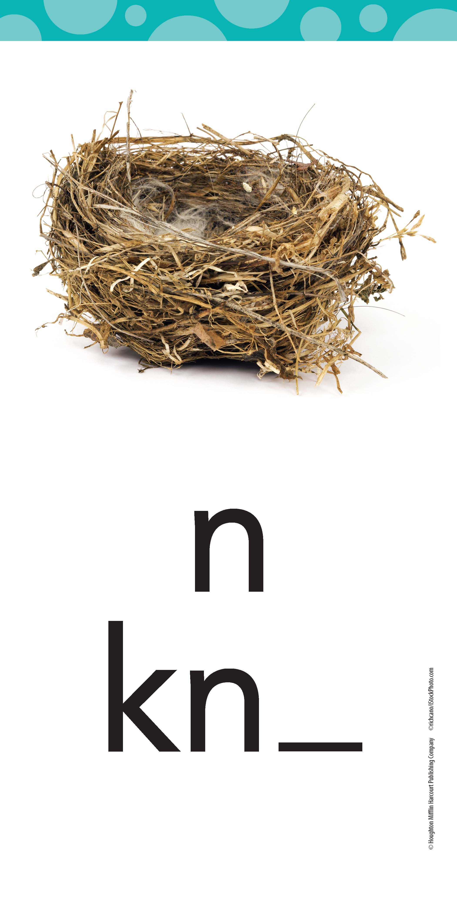
Sound for n as in NEST
Nan
©Houghton Mifflin Harcourt Publishing Company
Notes:
Say: Nest begins with the /n/ sound. The /n/ sound can have different spellings. One spelling for the /n/ sound is just the letter n. Look at the spelling that is circled under the picture of the nest, n.
Look at the word: /n/ /ă/ /n/, Nan. Remember, n is a consonant and a is a vowel, so it can stand for many sounds. When there is only one vowel in a word, and it is followed by a consonant, the vowel usually stands for the short vowel sound.
Use an Articulation Video to show children how to articulate the /d/ sound. If you are logged into Ed: Your Friend in Learning, you can copy and paste this link to access the video: https://www.hmhco.com/content/reading/common/reading_video_player/index.html?refid=kre_articulation_n_nest.

Slide 23
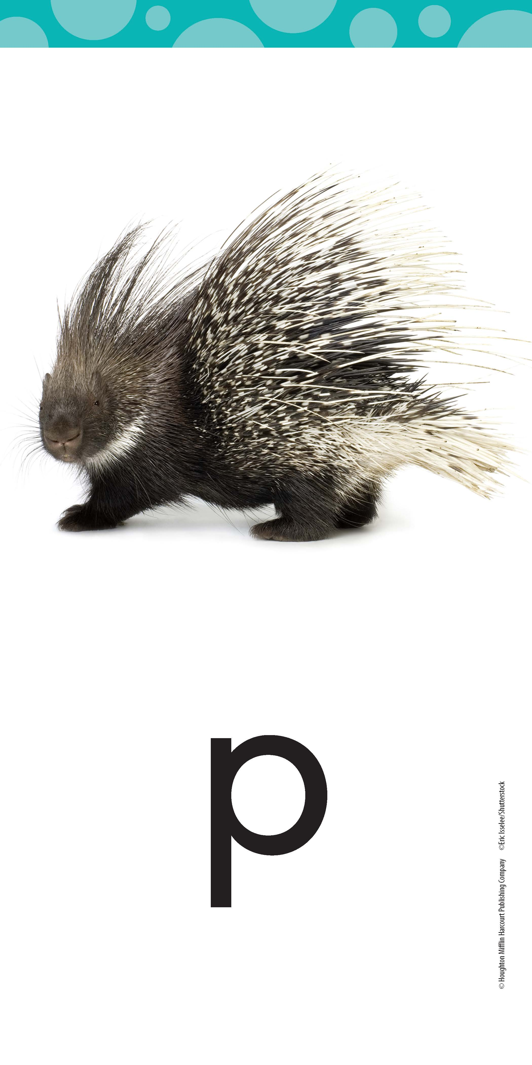
Sound for p as in PORCUPINE
pan
©Houghton Mifflin Harcourt Publishing Company
Notes:
Say: Porcupine begins with the /p/ sound. The letter p stands for the /p/ sound at the beginning of porcupine.
Look at the word: /p/ /ă/ /n/, pan. Remember, p is a consonant; a is a vowel, so it can stand for many sounds; and n is also a consonant. When there is only one vowel in a word, and it is followed by a consonant, the vowel usually stands for the short vowel sound.
Use an Articulation Video to show children how to articulate the /d/ sound. If you are logged into Ed: Your Friend in Learning, you can copy and paste this link to access the video: https://www.hmhco.com/content/reading/common/reading_video_player/index.html?refid=kre_articulation_p_pencil.

Slide 24
Let’s Blend!
1.
n
a
p
©Houghton Mifflin Harcourt Publishing Company
Notes:
Say: We are going to blend the letters in line 1 to read a word. The first letter is n, /n/.

Slide 25
Let’s Blend!
1.
n
a
p
2.
n
a
p
©Houghton Mifflin Harcourt Publishing Company
Notes:
Say: Let’s slide over the next letter in line 2. Remember that when there is only one vowel in a word, and it is followed by a consonant, the vowel usually stands for the short vowel sound. Let’s blend the two sounds. /n/ /ă/. /nă/.

Slide 26
Let’s Blend!
1.
n
a
p
2.
n
a
p
3.
n
a
p
©Houghton Mifflin Harcourt Publishing Company
Notes:
Say: Now let’s blend all the letters together in line 3: /nă/ /p/, nap. Read it with me: nap.

Slide 27
Let’s Blend!
1.
c
a
n
©Houghton Mifflin Harcourt Publishing Company
Notes:
Say: Let’s try it again. Look at line 1. The letter c stands for the /k/ sound.

Slide 28
Let’s Blend!
1.
c
a
n
c
a
n
2.
©Houghton Mifflin Harcourt Publishing Company
Notes:
Say: Let’s slide over the next letter in line 2. What sound does the vowel a stand for here? (/ă/) How do you know? (because the word has only one vowel and it is followed by a consonant) Let’s blend the two sounds. /k/ /ă/. /kă/.

Slide 29
Let’s Blend!
1.
c
a
n
c
a
n
2.
3.
c
a
n
©Houghton Mifflin Harcourt Publishing Company
Notes:
Say: Now let’s blend all the letters together in line 3: /kă/ /n/, can. Read it with me: can.

Slide 30
Let’s Blend!
1.
D
a
n
©Houghton Mifflin Harcourt Publishing Company
Notes:
Say: Let’s do one more word together. Look at line 1. The letter D stands for the /d/ sound.

Slide 31
Let’s Blend!
1.
D
a
n
2.
D
a
n
©Houghton Mifflin Harcourt Publishing Company
Notes:
Say: Let’s slide over the next letter in line 2. What sound does the vowel a stand for here? (/ă/) How do you know? (because the word only has one vowel and it is followed by a consonant) Let’s blend the two sounds. /d/ /ă/. /dă/.

Slide 32
Let’s Blend!
1.
D
a
n
2.
D
a
n
3.
D
a
n
©Houghton Mifflin Harcourt Publishing Company
Notes:
Say: Now let’s blend all the letters together in line 3: /dă/ /n/, Dan. Read it with me: Dan.
Good job!

Slide 33
Let’s Blend!
c
b
c
a
c
c
b
c
c
c
c
a
b
c
a
b
c
a
b
a
b
b
b
a
b
a
a
a
b
a
d
m
n
d
m
n
d
m
n
d
d
m
m
n
d
n
d
d
d
m
m
m
m
n
n
n
d
m
n
n
t
t
t
t
t
t
t
t
t
p
t
p
p
s
p
p
p
p
p
p
s
p
s
s
s
s
s
s
s
s
©Houghton Mifflin Harcourt Publishing Company
Notes:
OPTIONAL
If children need additional practice with the blending routine, build three words together using the sound-spellings provided. You can move the letter tiles at left into the blue boxes in each row to make words.
Suggested words:
an
cap
mad
man
pad
pat
tap

Slide 34
Let’s Blend!
sad | pan | map | cat
tan | mat | pat | bad
©Houghton Mifflin Harcourt Publishing Company
Notes:
Say: We’re going to read each line of words one at a time. Are you ready to read? Let’s start with line 1: sad, pan, map, cat.
Now look at line 2. Let’s read: tan, mat, pat, bad.
Good job!

Slide 35
Let’s Blend!
Which words rhyme with cat?
sad
pat
pan
bad
What other words rhyme with these words?
map
tan
mat
©Houghton Mifflin Harcourt Publishing Company
Notes:
Say: Now we are going to look for some words that rhyme with cat. Remember that rhyming words have the same ending sound.
Read the words on the left to yourself. Which words rhyme with cat? (mat, pat) Drag the word tiles to the spaces provided. What letters are the same in these words? (a, t) Blend the sounds with me: /ă/ /t/, /ăt/. Since rhyming words have the same vowel and consonant sounds, the words often have the same letters, or word family, at the end.
Do you know other words that rhyme with cat? Write a couple of their responses on the blank word tiles and drag them to the spaces provided.
Good job!

Slide 36
Let’s Blend!
Which words rhyme with tan?
sad
pat
pan
bad
What other words rhyme with these words?
map
cat
mat
©Houghton Mifflin Harcourt Publishing Company
Notes:
Say: Let’s look for more rhyming words. Which word on the list rhymes with tan? (pan) Drag the word tile to one of the spaces provided. What letters are the same in these words? (a, n) Blend the sounds with me: /ă/ /n/, /ăn/. Tan and pan also have the same word family at the end.
Do you know other words that rhyme with tan? Write a couple of their responses on the blank word tiles and drag them to the spaces provided.
Good job!

Slide 37
Let’s Blend!
Which words rhyme with sad?
pan
map
mat
What other words rhyme with these words?
cat
pat
tan
bad
©Houghton Mifflin Harcourt Publishing Company
Notes:
Say: One more time! Which word on the list rhymes with sad? (bad) Drag the word tile to one of the spaces provided. What letters are the same in these words? (a, d) Blend the sounds with me: /ă/ /d/, /ăd/. Sad and bad have the same word family at the end.
Do you know other words that rhyme with sad? Write a couple of their responses on the blank word tiles and drag them to the spaces provided.
Good job!

Slide 38
Short a sound as in ALLIGATOR
bad
©Houghton Mifflin Harcourt Publishing Company
Notes:
Say: We have learned to read more words with a short a vowel sound. Let’s practice spelling them, too, so we can use them in our own writing.
Look at our ALLIGATOR card again. All of this week’s spelling words have the short a sound, /ă/, spelled with the letter a, as in the word bad.
Remember that the /ă/ sound can be at the beginning or the middle of a word.

Slide 39
Let’s Sort!
other
pan
cat
can
nap
bad
sat
am
at
bat
an
©Houghton Mifflin Harcourt Publishing Company
Notes:
(Note: If you are present with children in a classroom, you may want to distribute Printable: Word List 2 to have children cut out the Spelling Word cards and sort the words. Save the cards and the rest of the page for later use.)
This sort has children distinguish among words that end with the letters an, words that end with the letters at, and words that do not belong in either of those categories. Move the word pan to head the first column and the word cat to head the second column. The third column is headed by the word other and is for words that do not fall into the first two columns.
Say: Let’s do some sorting with our new Spelling Words. These words all have the short a sound.
I will read a Spelling Word, and you will tell me if you hear the sounds /ăn/ at the end of the word, as in pan, or the sounds /ăt/ at the end of the word, as in cat. If the word does not end in the sounds /ăn/ or /ăt/, we will put it in the “other” column.
Listen as I do the first one: can. Listen for the ending sounds, /ăăăn/. I hear the /ăn/ sounds at the end of the word, as in pan. I’ll move can under pan.
Read each of the remaining words to children and have them tell you whether the Spelling Word ends with the sounds /ăn/, as in pan, the sounds /ăt/, as in cat, or neither.
Say: Great! Now let’s look closely at the words sorted into their correct columns. What do you notice about the words under pan? (They end with the /ăn/ sounds and they rhyme.)
And what do you notice about the words under cat? (They end with the /ăt/ sounds and they rhyme.)
As appropriate, assign children to practice sorting and writing the Spelling Words throughout the week.
Assign the Review and Challenge words below as needed for additional practice or extra challenge.
REVIEW: am, at, sat, bat
CHALLENGE: trap, lamp
You may also want to assign Know It, Show It page 16 for independent work.

Slide 40
Let’s Write!
©Houghton Mifflin Harcourt Publishing Company
Notes:
Say: Next we are going to continue to practice writing some of the letters that are in your Spelling Words. Get out a piece of paper [or a white board] to get ready. (You may want to distribute Printables: Manuscript Aa, Dd for children to use for practice during this activity.)
When you write, the position of your paper is important. It should be slanted along the line of the arm you are writing with, and you can use your other hand to hold your paper still. Practice this by getting in a good writing position.
Now look at the letters on the screen: lowercase a, lowercase d.
Remember that to write a, you start just below the middle line. Pull back, around, up to the middle line, and then down. Practice this with your finger.
Remember that to write d, start just below the middle line. Pull back, around, up to the top line, and then down. Practice this with your finger.
You may want to use the drawing tool to model writing the letter forms following the numbered strokes. Go up to the Draw menu, select a pen, and write each letter on the line next to the example as you say the numbered steps aloud. Repeat as needed.
Look carefully at the letters on the screen. How are the lowercase a and d alike? (They are both formed in a similar way, and they look similar to each other.)
Now let’s use the Write and Reveal routine to practice writing a word that include lowercase a and d.
You will write the word bad ending with lowercase d.
Write your answer.
Now turn your paper around to show it. (As appropriate, give positive or corrective feedback based on what you see.)
Repeat with the words an and at to provide practice for lowercase a.

Slide 41
Now we are ready to read Dan Can Tap, Tap, Tap.
Let’s Read!
©Houghton Mifflin Harcourt Publishing Company
Notes:
Say: Now we are ready to read about Dan and Tab in a story called “Dan Can Tap, Tap, Tap”! Do you remember the different ways we guessed that Dan might tap?
Meet with small groups to read the Start Right Reader decodable text “Dan Can Tap, Tap, Tap,” using the instructional support in your Teacher’s Guide small-group pages for Module 1, Lesson 6. You may also choose to have children read the story independently.

